Slide 1
Mechanisms and Robotics Laboratory Exercises - Day 1

Slide 2
Contents
Exercises Day - 1
Mapping-1: Rotation of a frame
Mapping - 2: Multiple Rotations of a frame
Notes:
References:
https://opentextbc.ca/teachinginadigitalage/chapter/section-8-1-a-short-history-of-educational-technology/?utm_source=timminstoday.com&utm_campaign=timminstoday.com&utm_medium=referral
https://www.riemysore.ac.in/ict/unit__7__elearning.html#7.5
https://www.youtube.com/watch?v=jTH3ob1IRFo
Skinner, B. (1968) The Technology of Teaching, 1968. New York: Appleton-Century-Crofts

Slide 3
Problem No. 1
The coordinates of point P in frame {1} are [3 2 1]^{T} . The position vector P is rotated about the z-axis by 45^{o.} Find the coordinates of point Q, the new position of point P.

Slide 4
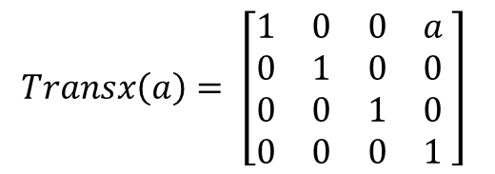
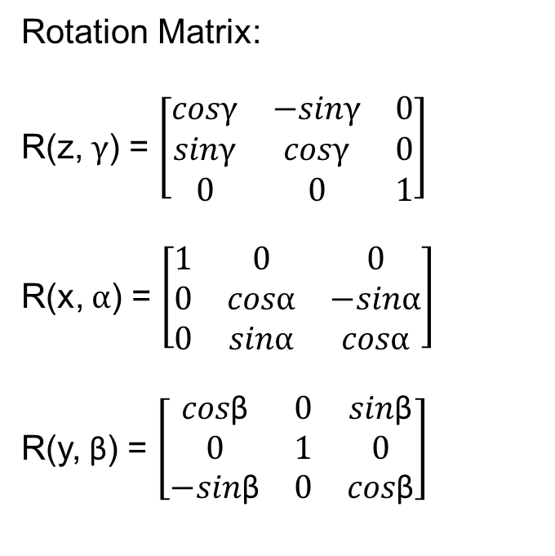
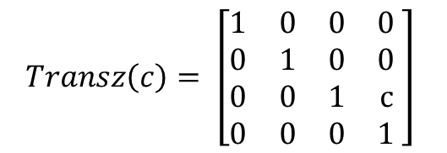
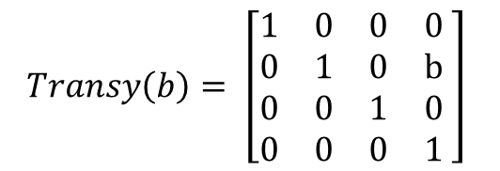
Solution
Rotation Matrix:
R(z, $γ$) = $\left[\begin{matrix}cosγ & −sinγ & 0 \\ sinγ & cosγ & 0 \\ 0 & 0 & 1\end{matrix}\right]$
R(x, $α$) = $\left[\begin{matrix}1 & 0 & 0 \\ 0 & cosα & −sinα \\ 0 & sinα & cosα\end{matrix}\right]$
R(y, β) = $\left[\begin{matrix}cos\text{β} & 0 & sin\text{β} \\ 0 & 1 & 0 \\ −sin\text{β} & 0 & cos\text{β}\end{matrix}\right]$
$$Transx\left(a\right)= \left[\begin{matrix}1 & 0 & 0 & a \\ 0 & 1 & 0 & 0 \\ 0 & 0 & 1 & 0 \\ 0 & 0 & 0 & 1\end{matrix} \right]$$
$$Transy\left(b\right)= \left[\begin{matrix}1 & 0 & 0 & 0 \\ 0 & 1 & 0 & b \\ 0 & 0 & 1 & 0 \\ 0 & 0 & 0 & 1\end{matrix} \right]$$
$$Transz\left(c\right)= \left[\begin{matrix}1 & 0 & 0 & 0 \\ 0 & 1 & 0 & 0 \\ 0 & 0 & 1 & c \\ 0 & 0 & 0 & 1\end{matrix} \right]$$

Slide 5
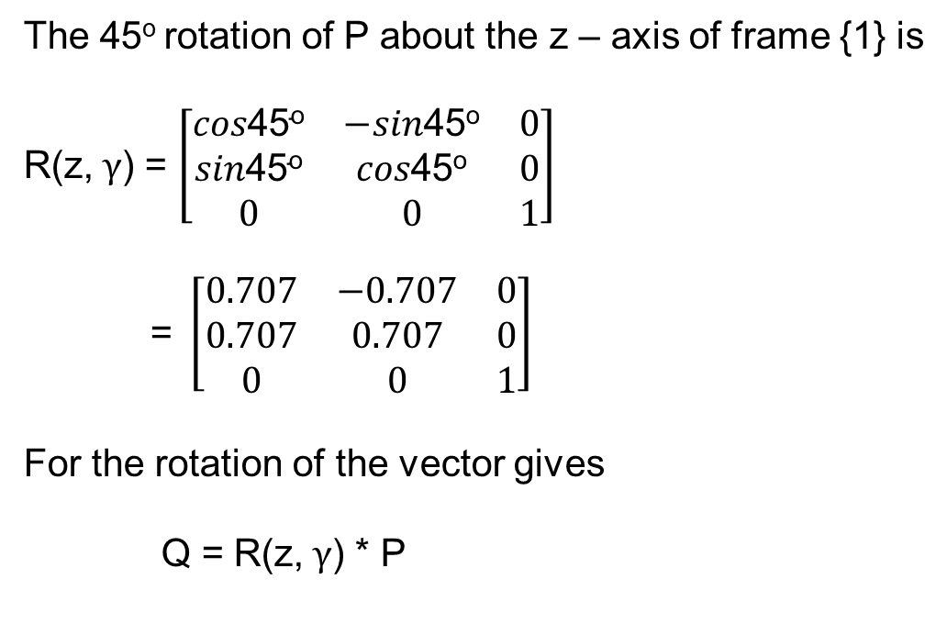
Solution
The 45º rotation of P about the z – axis of frame {1} is
R(z, $γ$) = $\left[\begin{matrix}cos\text{45}\text{o} & −sin\text{45}\text{o} & 0 \\ sin\text{45}\text{o} & cos\text{45}\text{o} & 0 \\ 0 & 0 & 1\end{matrix}\right]$
= $\left[\begin{matrix}0.707 & −0.707 & 0 \\ 0.707 & 0.707 & 0 \\ 0 & 0 & 1\end{matrix}\right]$
For the rotation of the vector gives
Q = R(z, $γ$) * P

Slide 6

Solution
Q = $\left[\begin{matrix}0.707 & −0.707 & 0 \\ 0.707 & 0.707 & 0 \\ 0 & 0 & 1\end{matrix}\right]\left[\begin{matrix}3 \\ 2 \\ 1\end{matrix}\right]$
Q = $\left[\begin{matrix}0.707 \\ 3.535 \\ 1\end{matrix}\right]$

Slide 7
Solution
MATLAB Code:
clc
close all
t1=input('Enter the link angle with Z=')
Rz=[cosd(t1) -sind(t1) 0;sind(t1) cosd(t1) 0;0 0 1]
P=[3;2;1]
Q=Rz*P

Slide 8
Mapping - 2: Multiple Rotations of a frame

Slide 9
Problem No. 2
Certain rotations are carried out about the axis of the fixed frame, first rotation about x-axis by 45º then about y-axis by 30º and finally about x-axis by 60º . Obtain the equivalent rotation matrix.

Slide 10
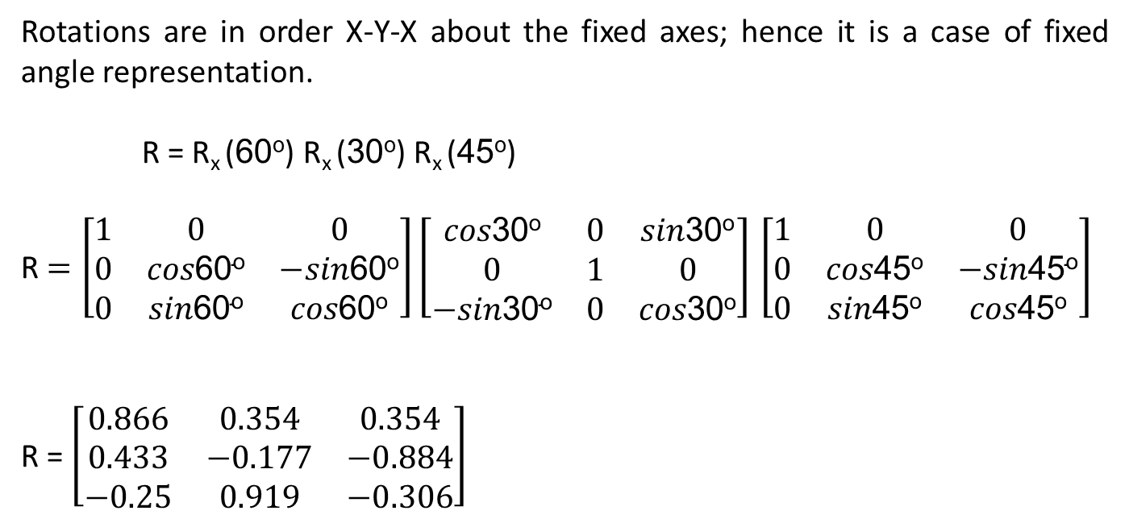
Solution
Rotations are in order X-Y-X about the fixed axes; hence it is a case of fixed angle representation.
R = R_{x} (60º) R_{x} (30º) R_{x} (45º)
R $=\left[\begin{matrix}1 & 0 & 0 \\ 0 & cos\text{60}\text{o} & −sin\text{60}\text{o} \\ 0 & sin\text{60}\text{o} & cos\text{60}\text{o}\end{matrix}\right]\left[\begin{matrix}cos\text{30}\text{o} & 0 & sin\text{30}\text{o} \\ 0 & 1 & 0 \\ −sin\text{30}\text{o} & 0 & cos\text{30}\text{o}\end{matrix}\right]$ $\left[\begin{matrix}1 & 0 & 0 \\ 0 & cos\text{45}\text{o} & −sin\text{45}\text{o} \\ 0 & sin\text{45}\text{o} & cos\text{45}\text{o}\end{matrix}\right]$
R = $\left[\begin{matrix}0.866 & 0.354 & 0.354 \\ 0.433 & −0.177 & −0.884 \\ −0.25 & 0.919 & −0.306\end{matrix}\right]$

Slide 11
MATLAB Code:
clc
clear all
t1=input('Enter the link angle with x1=')
t2=input('Enter the link angle with y=')
t3=input('Enter the link angle with x2=')
Rx1=[1 0 0; 0 cosd(t1) -sind(t1); 0 sind(t1) cosd(t1)]
Ry=[cosd(t2) 0 sind(t2); 0 1 0; -sind(t2) 0 cosd(t2)]
Rx2=[1 0 0; 0 cosd(t3) -sind(t3); 0 sind(t3) cosd(t3)]
R = Rx2*Ry*Rx1

